Slide 1


FIT9136 PASS WEEK 6
Introduction to Object-Oriented Programming (Classes & Objects)
26th Aug 2024
CL_33 Innovation Walk, Room C107 / Online

Slide 2





Attendance & Resources
Attending sessions is not mandatory but highly recommended.
Attendance is not assessed.
Any questions? Email me: harry.wang1@monash.edu
Also find the drive to receive the weekly slides: https://tinyurl.com/FIT9136-PASS
Monday 2-3pm
Tuesday 9-10am
Tuesday 4-5pm

Slide 3
Agenda
01
Material Recap 35 mins
Concept recap + practice + solution
02
Tiny Practice - 10 mins
Concept recap + practice + solution
03
Closure speaking - 15 mins
Conclusion + Q&A + Attendance recording

Slide 4
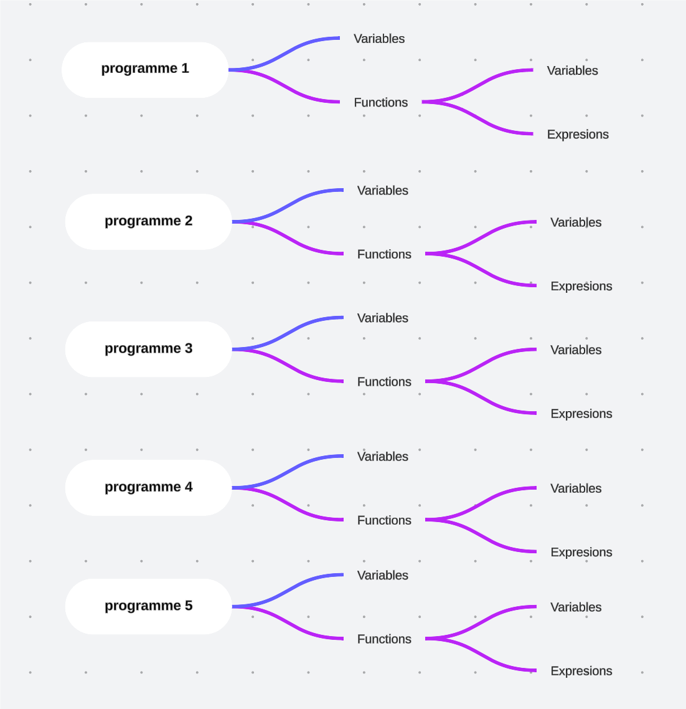

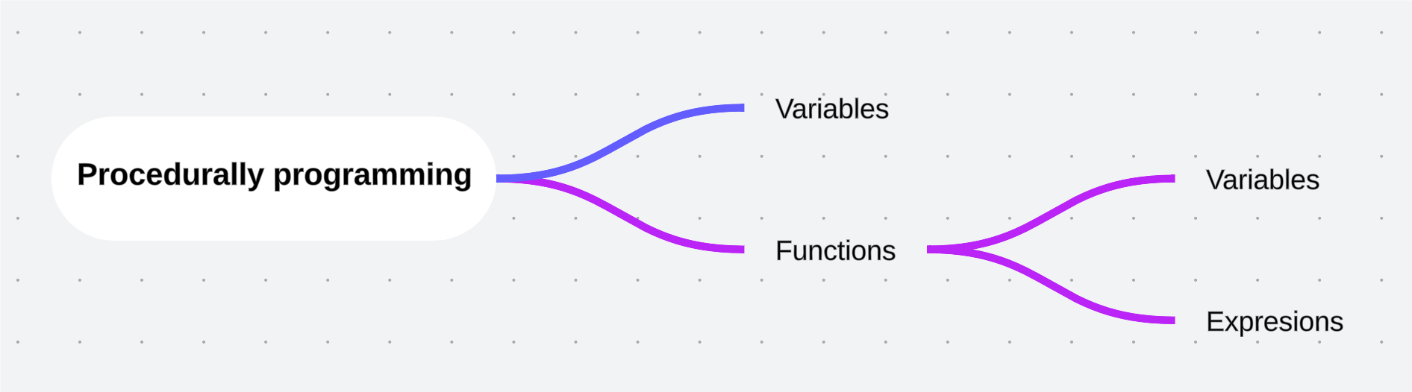
Procedural Programming (PP)
Procedural programming is a programming paradigm that relies on the concept of the procedure call. Procedures, also known as routines or functions, contain a series of computational steps to be carried out. In procedural programming, the program is composed of a sequence of instructions that are executed one after another.

Slide 5
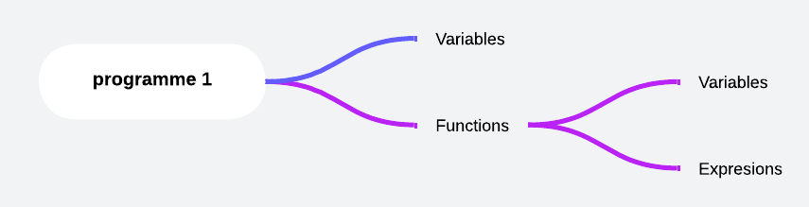
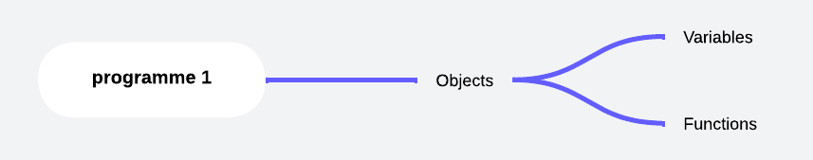
Expand the PP Logic (Code Complexity)
Number of functions
Number of Variables
Next level encapsulation
Number of Objects

Slide 6
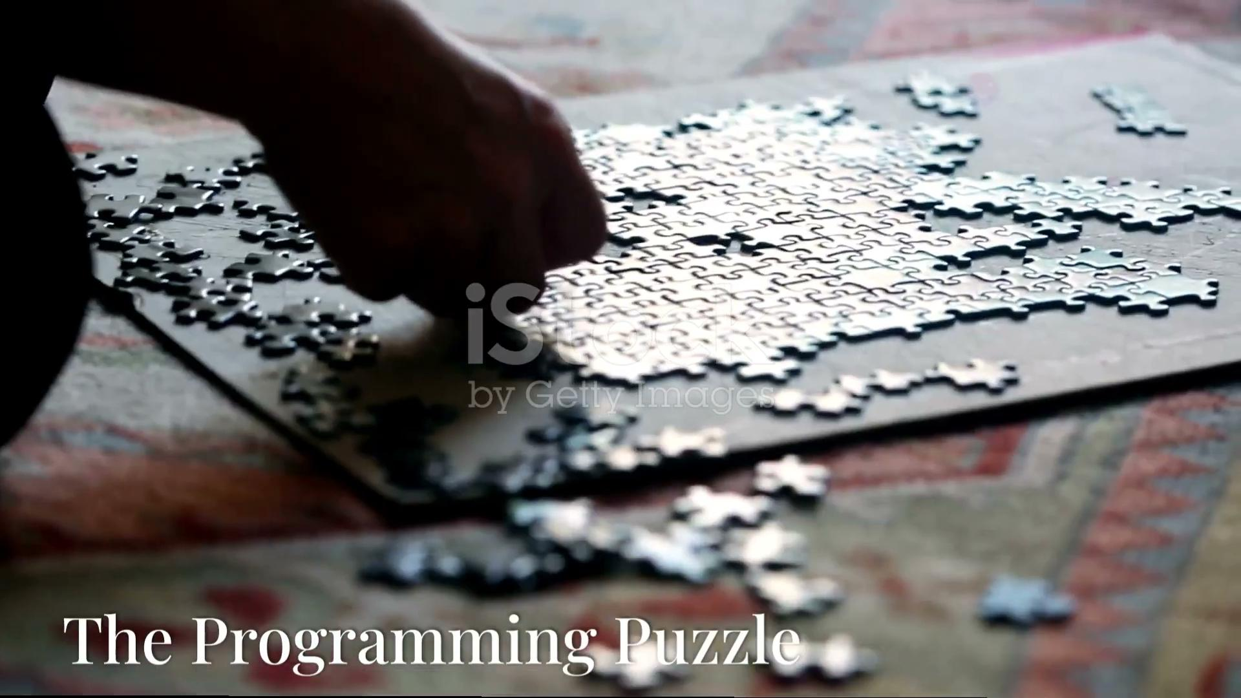
Object-Oriented Programming (OOP)
Jigsaw Puzzle:
More pieces -> More details
Expand the plate -> Add more pieces
Can not complete the whole?
-> start from smaller plate first~~

Slide 7
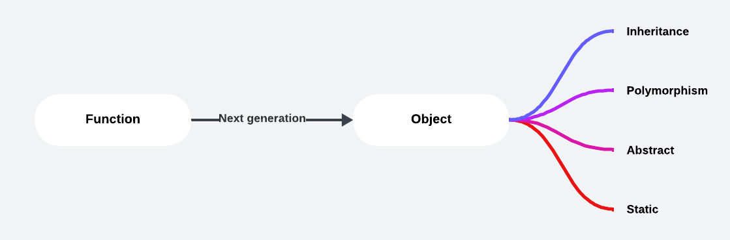
Why don’t Use Function?

Slide 8
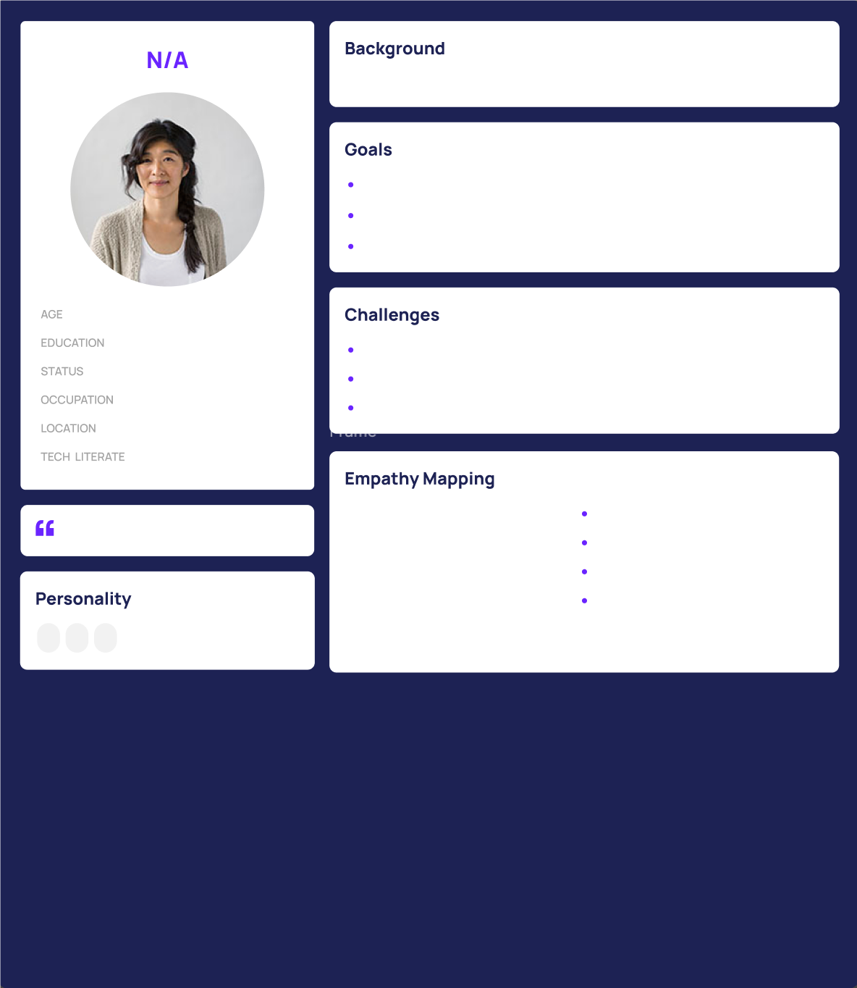
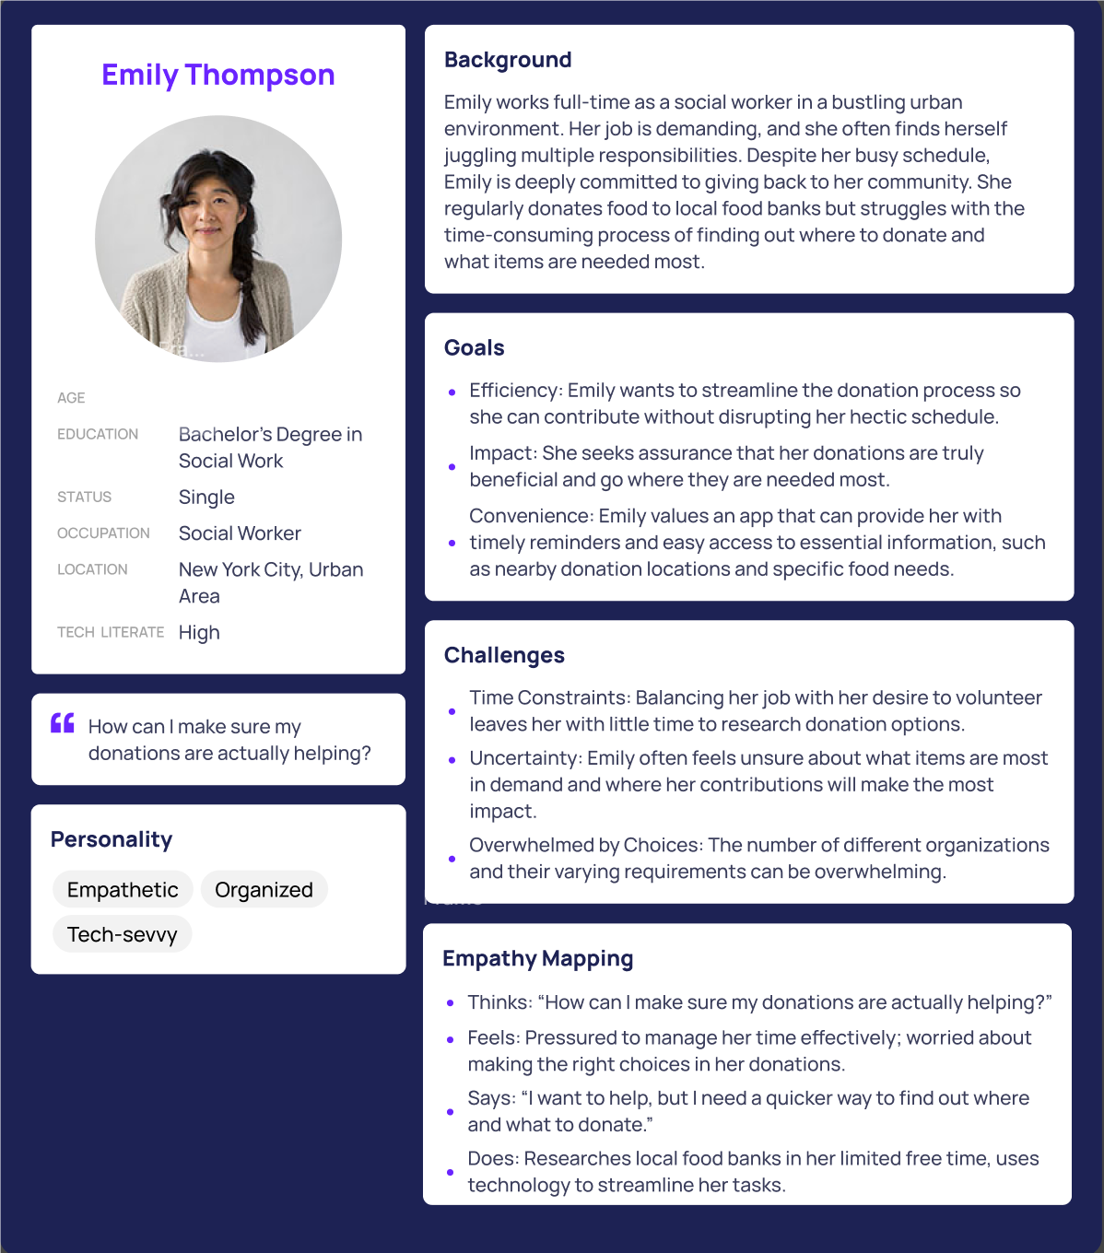
OOP Manipulations
Class: profile template
Object: your personal profile

Slide 9
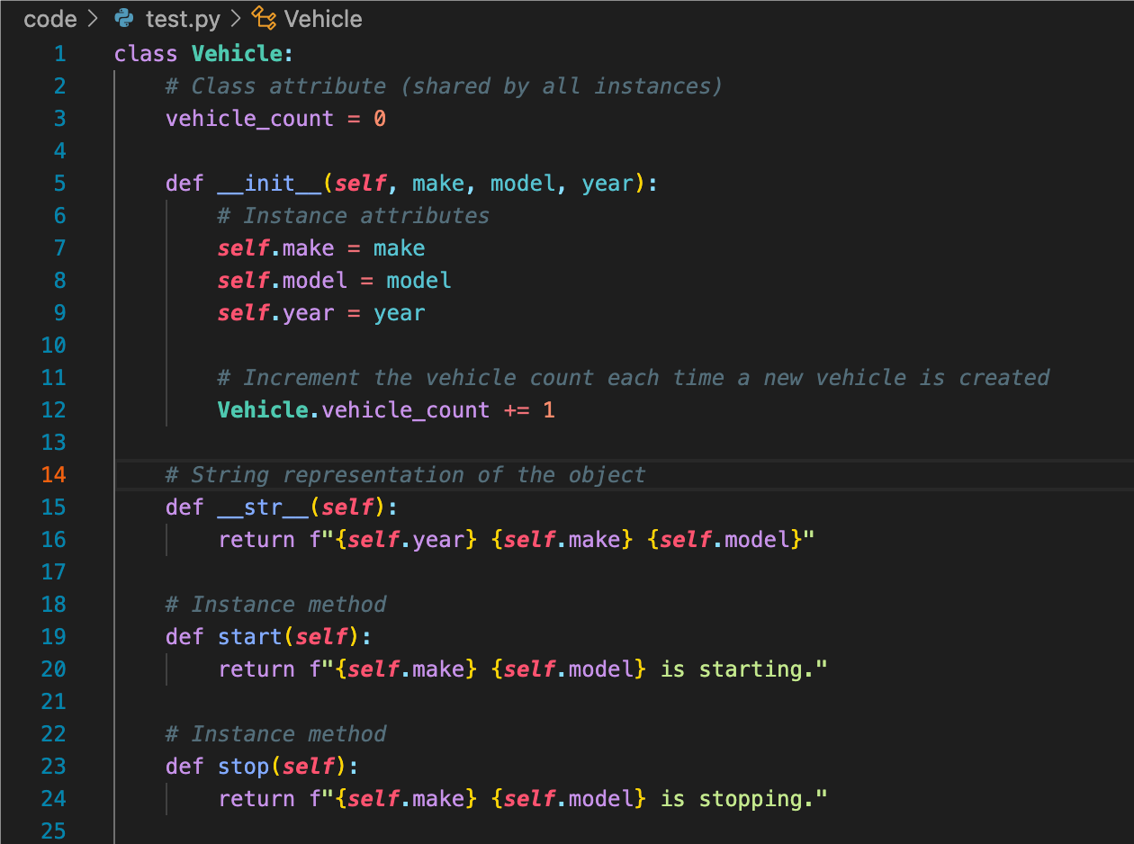
Class Components
__init__ (constructor): Object Variables
__str__: Present the object by string
Other functions
Class Variables

Slide 10
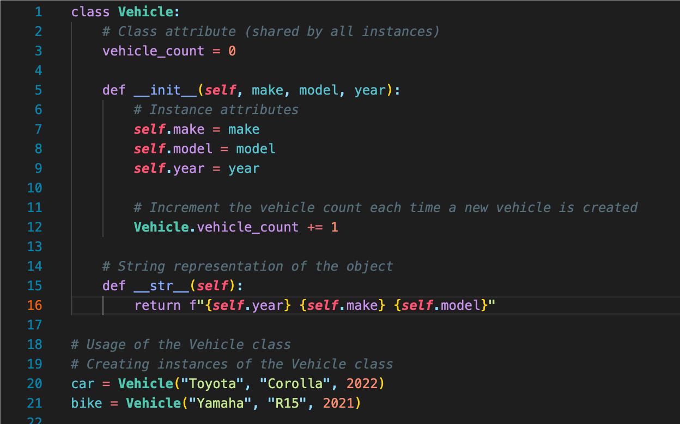
Instantiation
__init__ (constructor) is typically called to initialize the newly created object.

Slide 11
Base Code: https://tinyurl.com/FIT9136-PASS /Week6/code
Tiny Practice
1. Encapsulation:
• The Book, Member, and Library classes encapsulate data and behavior. This means that related data and functions are bundled together, making the code easier to manage and understand.
2. Reusability:
• Each class can be reused independently. For example, if you wanted to create a separate program that just manages books, you could reuse the Book class without modification.
3. Maintenance:
• If you need to make changes, such as adding new features or modifying behavior, you can do so within the relevant class, without having to touch unrelated code. This makes the code more maintainable.
4. Scalability:
• The OOP approach scales better as your system grows. If you want to add new functionality, like managing DVDs or e-books, you can create new classes or extend existing ones without rewriting large portions of the code.
Task:
Download both files
Have a look at them
See what is the difference

Slide 12

Let’s see what we got today
What is OOP? Why are people using this programming style?
How to do OOP? How to create a class or an object?

Slide 13
Attendance & Resources
Attending sessions is not mandatory but highly recommended.
Attendance is not assessed.
Any questions? Email me: harry.wang1@monash.edu
Also find the drive to receive the weekly slides: https://tinyurl.com/FIT9136-PASS
Monday 2-3pm
Tuesday 9-10am
Tuesday 4-5pm

Slide 14
Thank You
26th Aug 2024
CL_33 Innovation Walk, Room C107 / Online

Slide 15
Questions & Answers
26th Aug 2024
CL_33 Innovation Walk, Room C107 / Online

